Slide 1
Data Journalism for Elections
Kabul, Afghanistan March 23-27, 2014

Slide 2
Finding Data For Elections

Slide 3
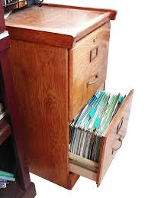
A very common data format …

Slide 4
Where is Data
Data is Collected Every Time Something is:
Registered
Inspected
Purchased
Voted on
Surveyed

Slide 5
Contents
Understanding Data Formats
Machine readable and unstructured
Scanned and computer-generated
Converting scanned images into useable formats
Converting unstructured formats into machine readable formats
Understanding Data
Concepts
Causation vs Correlation
Crime Data
Polling and Margin of Error
Exercise
Finding Data on the Web
Data Formats for Download
Advanced Google Searches
Election Data Resources
No Excuses!
Exercise
Summary & Resources

Slide 6
Understanding Data Formats
Machine readable
CSV (comma-separated values) or TSV (tab-separated values), Excel (.xls)
Unstructured
(PDF, Word) and bitmap images (GIF, JPEG, PNG, BMP)

Slide 7
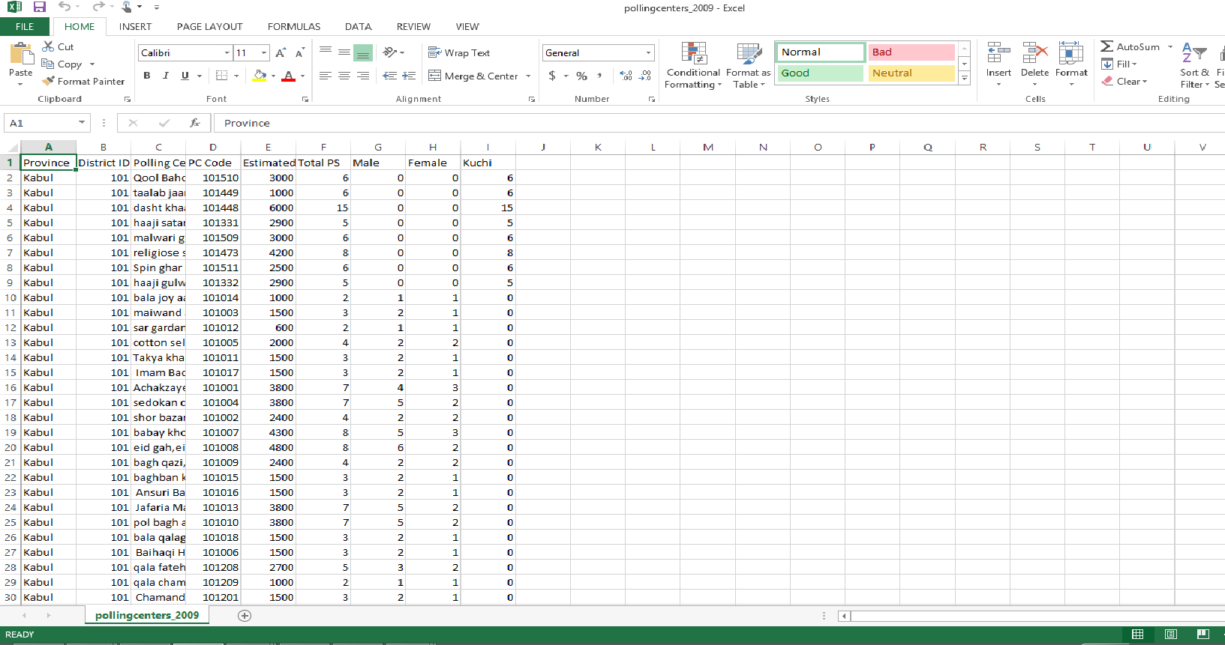
Understanding Data Formats Machine Readable

Slide 8
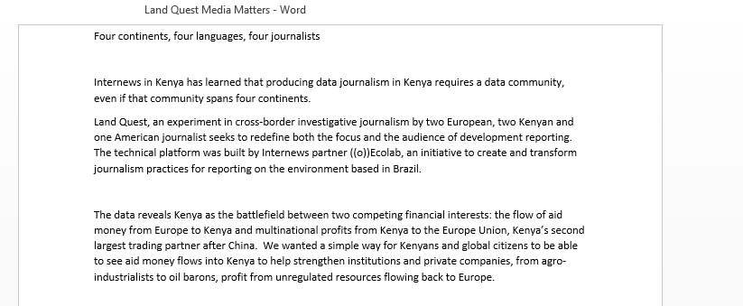
Understanding Data Formats Unstructured

Slide 9
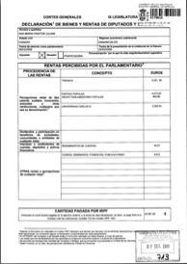
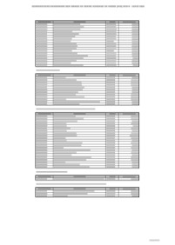
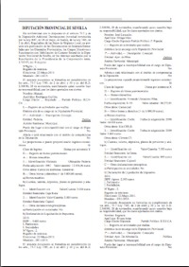
Understanding Data Formats
PDFs
Scanned Images (Unstructured, not searchable)
Computer-generated (searchable)
Tables (Structured, searchable)
Complex formats (Unstructured, searchable)

Slide 10
Understanding Data Formats: Machine-generated PDFs
Copying and pasting into Excel does not usually work
Free online tools for data in English:
cometdocs.com
pdftoexcelonline.com
zamzar.com
pdftoexcel.org
Free desktop software
tabula.nerdpower.org

Slide 11
Understanding Data Formats: Scanned Images
Optical Character Recognition Software
For documents that you can’t search or select text
Quality depends on quality of image, clarity of text
Adobe Acrobat Professional: paid
Google Docs: free
Document Cloud: free. Advantage is that it allows you to annotate and publish your document as part of a multimedia publication. Your media outlet must request an account.

Slide 12
Understanding Data Formats: Unstructured
Columns, data divided among various lines, mixed with text
Automatic tools probably won’t work
The PDFs will have to be extracted and a programmer will use programming language to create a program to extract the data that you want

Slide 13
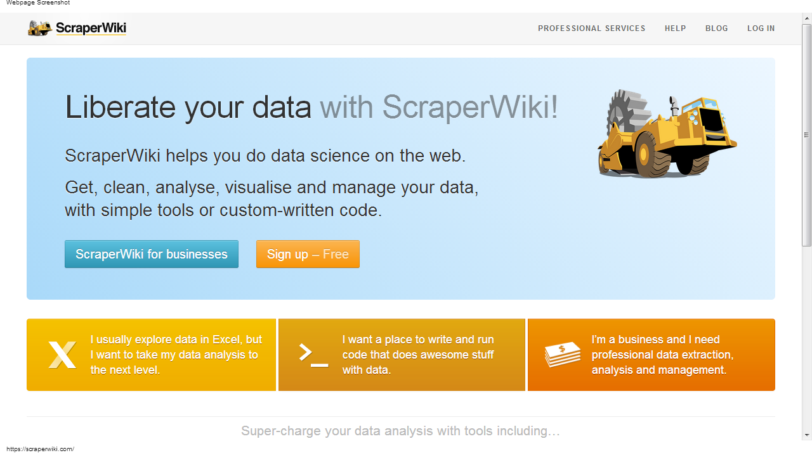
Understanding Data Formats: Unstructured: Scraper Wiki

Slide 14
Contents
Understanding Data Formats
Machine readable and unstructured
Scanned and computer-generated
Converting scanned images into useable formats
Converting unstructured formats into machine readable formats
Understanding Data
Concepts
Causation vs Correlation
Crime Data
Polling and Margin of Error
Exercise
Finding Data on the Web
Data Formats for Download
Advanced Google Searches
Election Data Resources
No Excuses!
Exercise
Summary & Resources

Slide 15
Understanding Data: Questions to Ask
Where have you come from? Every statistic has a creator, someone who has put it out there for a reason. One of the most important things to find out is who this is.
Do the creators have a hidden agenda or vested interests that might skew their interpretation? Does the figure come from a company trying to show that its particular merchandise is the best? Does it come from a political party trying to spin a good image?

Slide 16
Understanding Data: Concepts
How was the data collected and could it have been collected in a better way? Find out exactly what is being measured and how.
Sample size: How many people were surveyed?
Random sampling: Was the survey targeted at an audience (magazine readers, users of a product) or were they selected randomly?

Slide 17
Understanding Data: Causation vs. Correlation
Ice cream consumption rises in the summer
Heart attacks rise in the summer
Does ice cream cause heart attacks?
Does heat cause increased ice cream consumption and heart attacks?
Do ice cream promotions in the summer cause increased ice cream consumption?
Does increased physical activity in the summer cause heart attacks?
Do external factors we don’t know about cause these increases?

Slide 18
Understanding Data: Crime Data
Is it statistically significant when compared to the rest of the country or past years? (5% increase in local crime when there was a 7% national increase, or a 6% increase in 2012)
Is there a factor skewing results? (a terrorist attack that caused a results spike or someone who underreports crimes against vulnerable groups?
Is it a factor of higher police presence? (Drug offences only soar if there are police around to catch them)

Slide 19
Understanding Data: Crime Data
Is it statistically significant when compared to the rest of the country or past years? (5% increase in local crime when there was a 7% national increase, or a 6% increase in 2012)
Is there a factor skewing results? (a terrorist attack that caused a results spike or someone who underreports crimes against vulnerable groups?
Is it a factor of higher police presence? (Drug offences only soar if there are police around to catch them)

Slide 20
Understanding Data: Polling & Margin of Error
The margin of error in a sample = 1 divided by the square root of the number of people in the sample
If a poll has a margin of error of 2.5 percent, that means that if you ran that poll 100 times — asking a different sample of people each time — the overall percentage of people who responded the same way would remain within 2.5 percent of your original result in at least 95 of those 100 polls.

Slide 21
Understanding Data: Polling & Margin of Error
The margin of error in a sample = 1 divided by the square root of the number of people in the sample
If a poll has a margin of error of 2.5 percent, that means that if you ran that poll 100 times — asking a different sample of people each time — the overall percentage of people who responded the same way would remain within 2.5 percent of your original result in at least 95 of those 100 polls.

Slide 22
Understanding Data: Why is Margin of Error Important?
Case study of exaggerated poll result “Candidate A lead over candidate B grows by 2 points in August to 56% of votes”
If the margin of error is 2.5%, then the July poll results were 54%, with a 2.5 margin of error could have been 51.5% or 56.5%. The August poll results could have been 56%, or 53.5% or 58.5%
This means there are NO RESULTS TO REPORT!

Slide 23
Understanding Data: Exercise
Read:
How reliable is the collection methodology?
Who is the source of the information?
Were the statistics reported accurately?
Were they put in appropriate context?
Was the margin of error accurately reported?

Slide 24
Contents
Understanding Data Formats
Machine readable and unstructured
Scanned and computer-generated
Converting scanned images into useable formats
Converting unstructured formats into machine readable formats
Understanding Data
Concepts
Causation vs Correlation
Crime Data
Polling and Margin of Error
Exercise
Finding Data on the Web
Data Formats for Download
Advanced Google Searches
Election Data Resources
No Excuses!
Exercise
Summary & Resources

Slide 25
Finding Data on the Web
Data Sources During the Election
Official press releases
Official election monitor reports
Crowd sourcing
Exit polls
Statistics to predict outcomes

Slide 26
Finding Data on the Web:
Data Formats for Download
Portable Document Format (PDF): charts that contain data but are saved in a unified document with text
Excel file (xls): data is saved as a table readable by Microsoft Excel
Comma separated values (CSV): Plain text file with each data separated by a comma

Slide 27
Finding Data: Advanced Google Searches
Type OR to find variations of the same search: China “elections” OR “voting” OR “polls”
Use quotes to search for phrases “Independent Election Commission of Afghanistan”
Narrow search to specific website: “site:url” Example “site:http://www.electionguide.org/ Afghanistan”
Narrow search to filetype: “Filetype:[extension]”
Example: http://www.worldbank.org/ Afghanistan security filetype:pdf
Also try http://www.google.com/advanced_search
Google alerts: get notified about your beat

Slide 28
Finding Data on the Web: Aghanistan Election Data
Independent Election Comission of Afghanistan
UNDP
International Foundation for Electoral Systems
National Democratic Institution
Integrity Watch Afghanistan
Afghanistan Election Data
Democracy International

Slide 29
Finding Data: No Excuses!
“We don’t have that data on a computer.”
High fees
Delay tactics
“Your request was unclear.”
Sending the wrong data
“Our database is too complicated to give you access.”
“Our database software is proprietary.”
“That information is protected by privacy law.”

Slide 30
Finding Data on the Web: Exercise
Afghanistan election guide: everything you need to know
Afghanistan's Future: Who's Who in Pivotal Presidential Election
Spate of attacks spark Afghan election fears

Slide 31
Finding Data on the Web: Exercise
Return to your lists of data that would enrich current election coverage
Search for data using databases and advanced searches.
Categorize the data you have by story angle

Slide 32
Summary & Resources
Data is available in many different formats and almost always you will need to convert data to an Excel or csv file.
It is important to develop a news nose for suspicious or exaggerated data findings and ask experts to evaluate validity
Every day, more data is available online and accessible through searches

